Slide 1
User Research Summary
Prepared by the Digital Service at Veterans Affairs (DSVA)
Prepared for and presented to the VA Web Brand Consolidation Working Group
April 26 2018

Slide 2
Outline
We gathered feedback from hundreds of Veterans about our plans for a new va.gov experience.
Study 1 – “Others” Resources Card Sort
Study 2 – Benefit Lifecycle Card Sort
Study 3a – Homepage Wireframes v1
Study 3b – Homepage Wireframes v2

Slide 3
Study 1 – “Others” Resources Card Sort

Slide 4
Our goal was to learn how to organize the "other" resources that don’t fit into the benefit categories.
Study objectives
Do we need to create additional benefit categories?
How do we treat edge case content/audience based content?
What labels work for these resources?

Slide 5
We let Veterans tell us how they would group the “other” resources
Research Method
Created an open card sort in Optimal Workshop
20 cards, user creates categories
Distributed to 4k Veterans via MyHealtheVet mailing list
Received 155 responses (Apr 5 – Apr 20)
95% Veterans, a few caregivers and family members

Slide 6
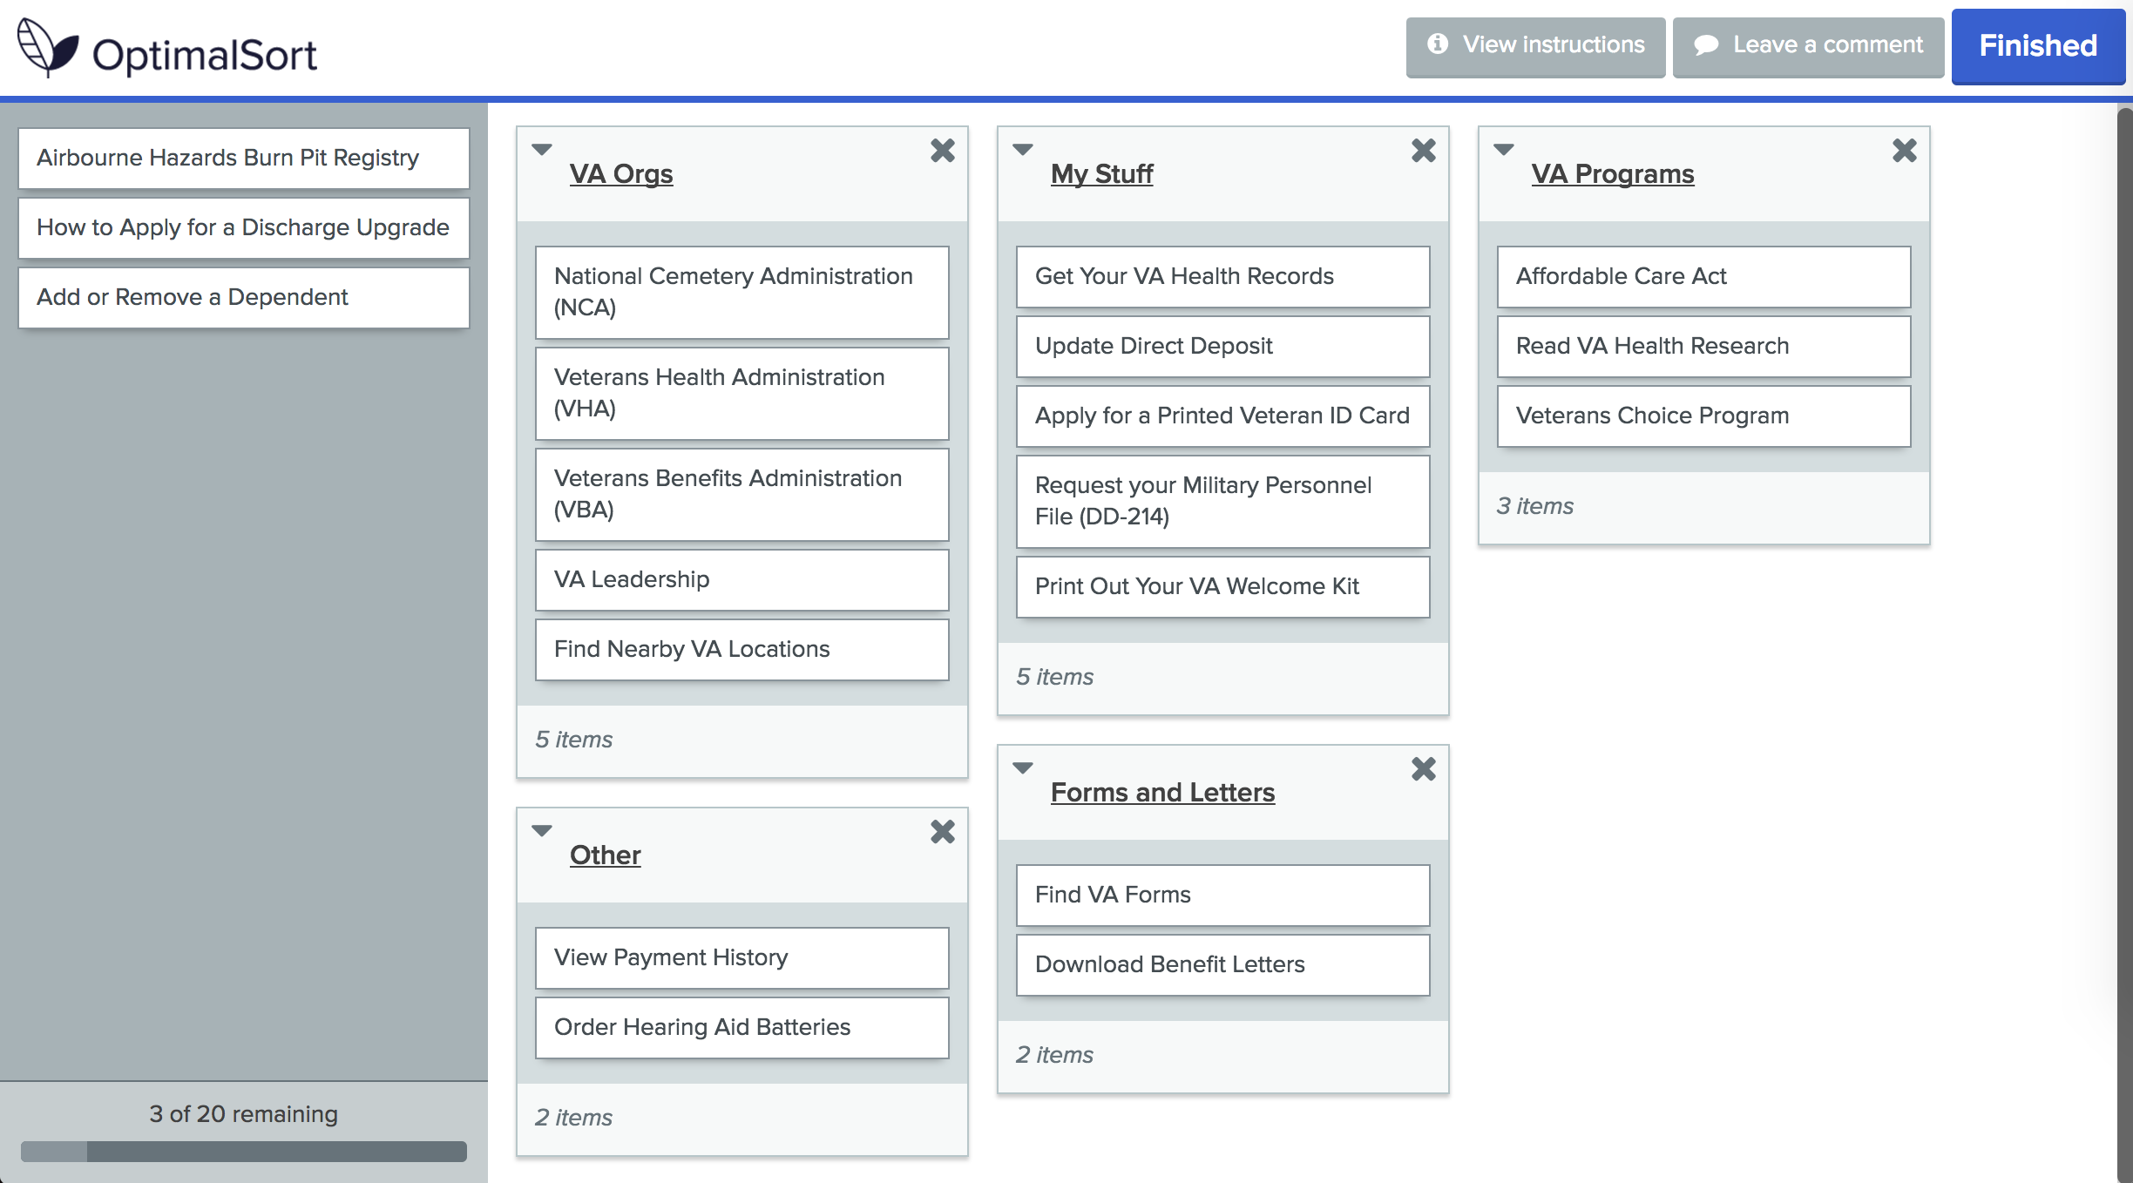
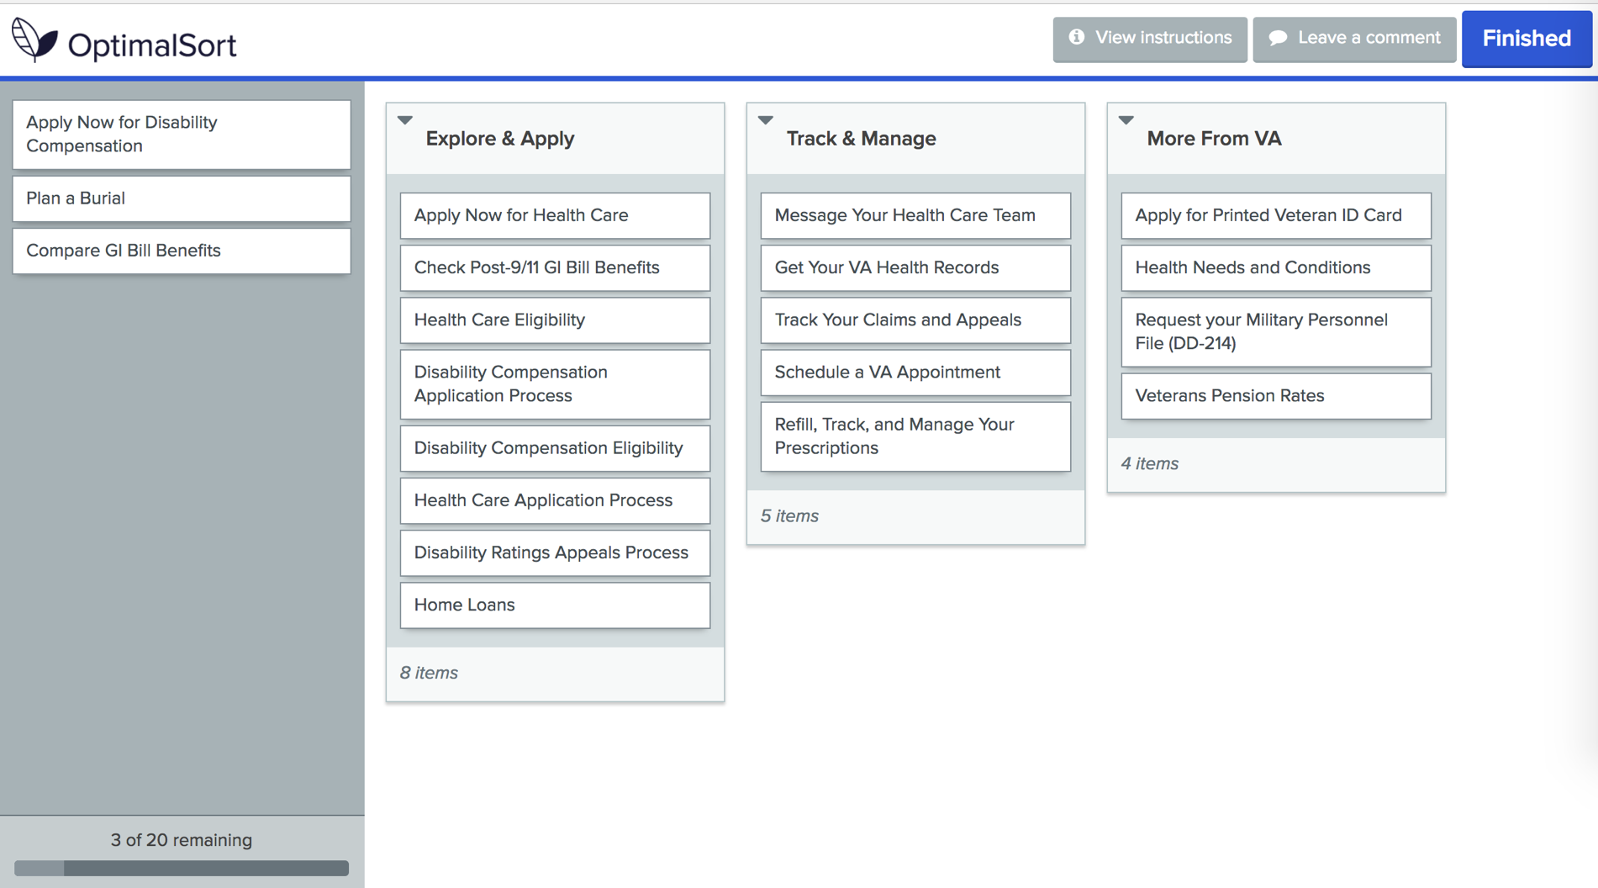

Slide 7
Veterans don’t agree on what to call these groups of content
Findings
Veteran’s groups had low agreement scores but provide valuable labels
Account Information / Management
About the VA
My VA / For Me
Most Important (focused on health due to audience)
Self Service / Online
Airborne Hazards and Ordering Hearing Aid Batteries were consistently outliers

Slide 8
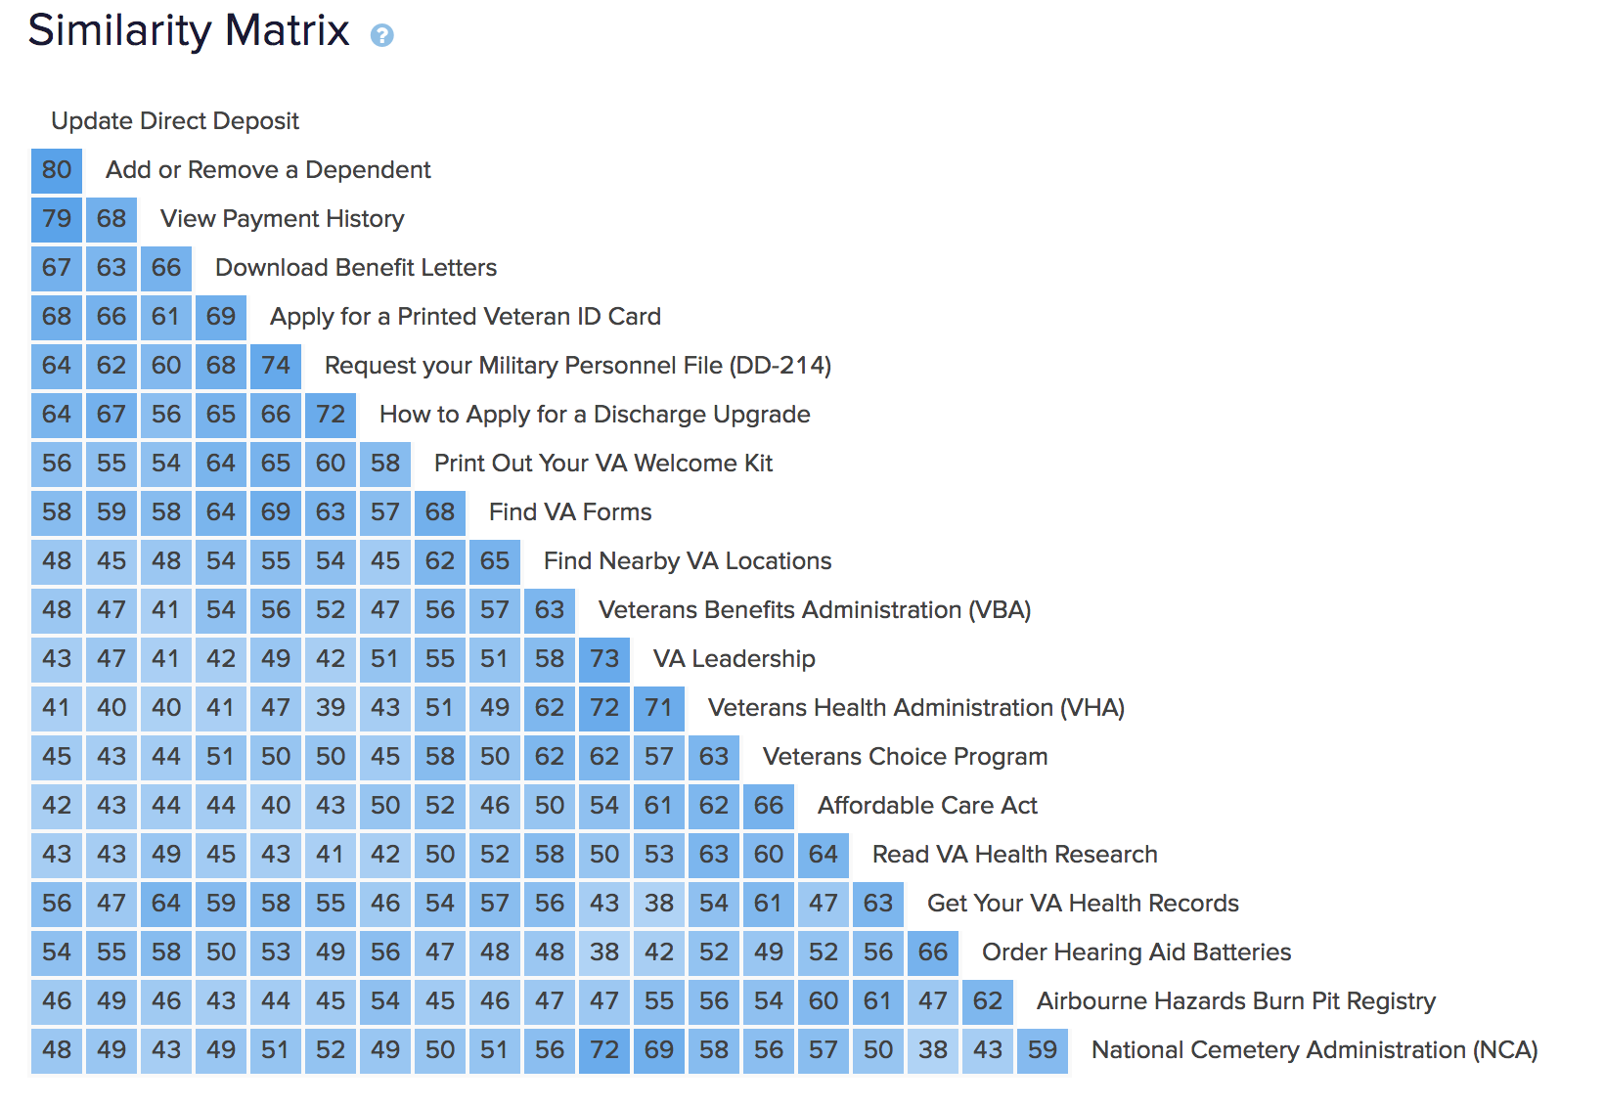
Veterans did not have a consistent way of organizing “other” benefits

Slide 9
What Now?
Recommendations
We confirmed that there is no clear or consistent way to group and label all the “other” content but the data still show items with the strongest relationship and provide Veteran-focused labels.

Slide 10
Groupings of items with the highest similarity
Group 1
Group 2
Group 3
Update Direct Deposit
Add or Remove a Dependent
View Payment History
Download Benefit Letters
Apply for a Printed Veteran ID Card
Request your Military Personnel File (DD-214)
How to Apply for a Discharge Upgrade
Find VA Forms
Find Nearby VA Locations

Slide 11
Groupings of items with the highest similarity
Group 4
Group 5
Group 6
Veterans Benefits Administration (VBA)
VA Leadership
Veterans Health Administration (VHA)
National Cemetery Administration (NCA)
Veterans Choice Program
Affordable Care Act
Read VA Health Research
Get Your VA Health Records
Order Hearing Aid Batteries

Slide 12
Study 2 – Benefit Lifecycle Card Sort

Slide 13
Our goal was to find if our proposed benefit lifecycle works for Veterans.
Study objectives
Can users consistently group content by the proposed spoke model?
Explore & Apply
Track & Manage
More From VA
What type of content ends up in "More From VA”?

Slide 14
Veterans showed us which of the buckets they would use to arrange the top links
Research Method
Created a closed card sort in Optimal Workshop
20 cards, 3 categories
Distributed to 4k Veterans via MyHealtheVet mailing list
Received 240 responses (Apr 5 – Apr 20)
95% Veterans, several spouses and other family

Slide 16
How we would have grouped the items…
Explore & Apply
Track and Manage
More From VA
Health Care Application Process
Health Care Eligibility
Apply Now for Health Care
Disability Compensation Eligibility
Disability Compensation Application Process
Apply Now for Disability Compensation
Apply for Printed Veteran ID Card
Refill, Track, and Manage Your Prescriptions
Message Your Health Care Team
Schedule a VA Appointment
Get Your VA Health Records
Track Your Claims and Appeals
Check Post-9/11 GI Bill Benefits
Request your Military Personnel File (DD-214)
Health Needs and Conditions
Disability Ratings Appeals Process
Compare GI Bill Benefits
Veterans Pension Rates
Plan a Burial
Home Loans

Slide 17
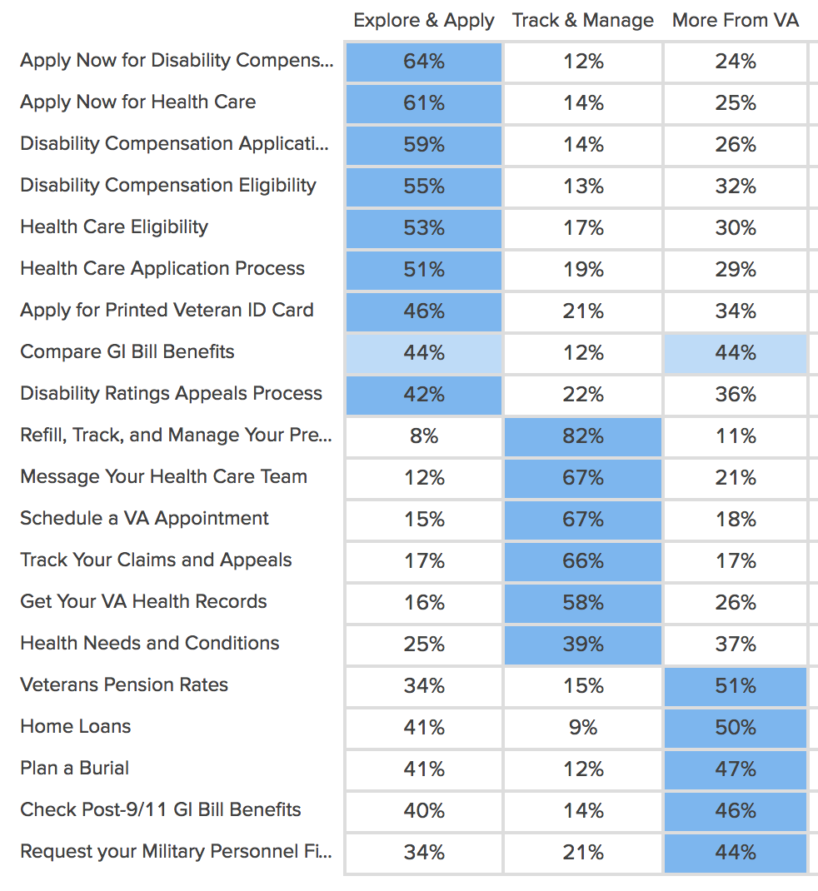
How Veterans grouped the items…

Slide 18
Some content worked better than others
Explore & Apply
Track and Manage
More From VA
Health Care Application Process
Health Care Eligibility
Apply Now for Health Care
Disability Compensation Eligibility
Disability Compensation Application Process
Apply Now for Disability Compensation
Apply for Printed Veteran ID Card
Refill, Track, and Manage Your Prescriptions
Message Your Health Care Team
Schedule a VA Appointment
Get Your VA Health Records
Track Your Claims and Appeals
Check Post-9/11 GI Bill Benefits
Request your Military Personnel File (DD-214)
Health Needs and Conditions
Disability Ratings Appeals Process
Compare GI Bill Benefits
Veterans Pension Rates
Plan a Burial
Home Loans

Slide 19
Organizing benefits around the lifecycle makes sense to Veterans
Findings
Explore & Apply works well for the items we thought fit in that category like “Health Care Eligibility”
Many Track & Manage cards were consistently sorted by Veterans, but other items including “Request DD-214” don’t fit
Several items including “Compare GI Bill Benefits” aren’t easily placed in only one category
More From VA cards had the most inconsistent placement but did not distract Veterans from the benefit lifecycle

Slide 20
What Now?
Recommendations
We learned that the benefit lifecycle can work as part of the content strategy but applying it to the content hubs will take finesse.

Slide 21
Applying the benefit lifecycle will require careful planning
Recommendations
Veterans consistently understand the difference between the Explore & Apply vs Track & Manage phases of the benefit lifecycle
Content should be tested before sorting it under a spoke, especially Track & Manage items
Veterans will not be distracted by a More From VA spoke but it cannot be used as a way to consistently locate content
Labels for content spokes can use the terms “Explore, Apply, Track, and Manage”

Slide 22
Study 3a – Homepage Wireframes v1

Slide 23
Our goal was to gather feedback on two homepage designs
Study objectives
Which of our wireframe concepts works best for Veterans?
What are the pros/cons of each?
How do Veterans prioritize the benefit categories?
What do Veterans think of the top task approach?
What do Veterans think of the lifecycle approach?

Slide 24
We spoke with Veterans in person to learn more about what works for them.
Research Method
Visited DC Medical Center – Women’s Clinic
Spoke with 10 women Veterans of varying ages and races
Showed them two options for a new homepage (paper wireframes)
Asked structured questions to gather feedback

Slide 25
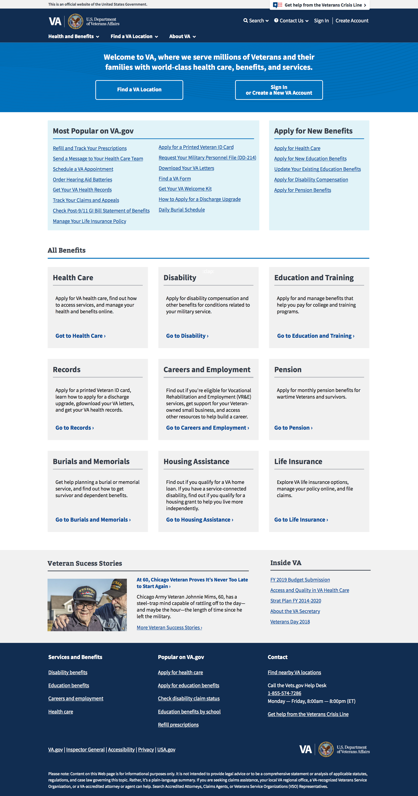
Research Method
Header
Zone 1 – Welcome, location, login
Zone 2 – Top tasks or benefits
Zone 3 – All benefits
Zone 4 – Good news stories, inside VA
Footer

Slide 26
Research Method
Header
Zone 1 – Welcome, location, login
Zone 2 – Top tasks or benefits
Zone 3 – All benefits
Zone 4 – Good news stories, inside VA
Footer

Slide 27
Top Tasks Homepage
Research Method
Zone 2 focused on the top tasks available to Veterans split between recurring “manage” and one time “apply” boxes
Zone 3 listed each benefit category with a simple description and CTA

Slide 28
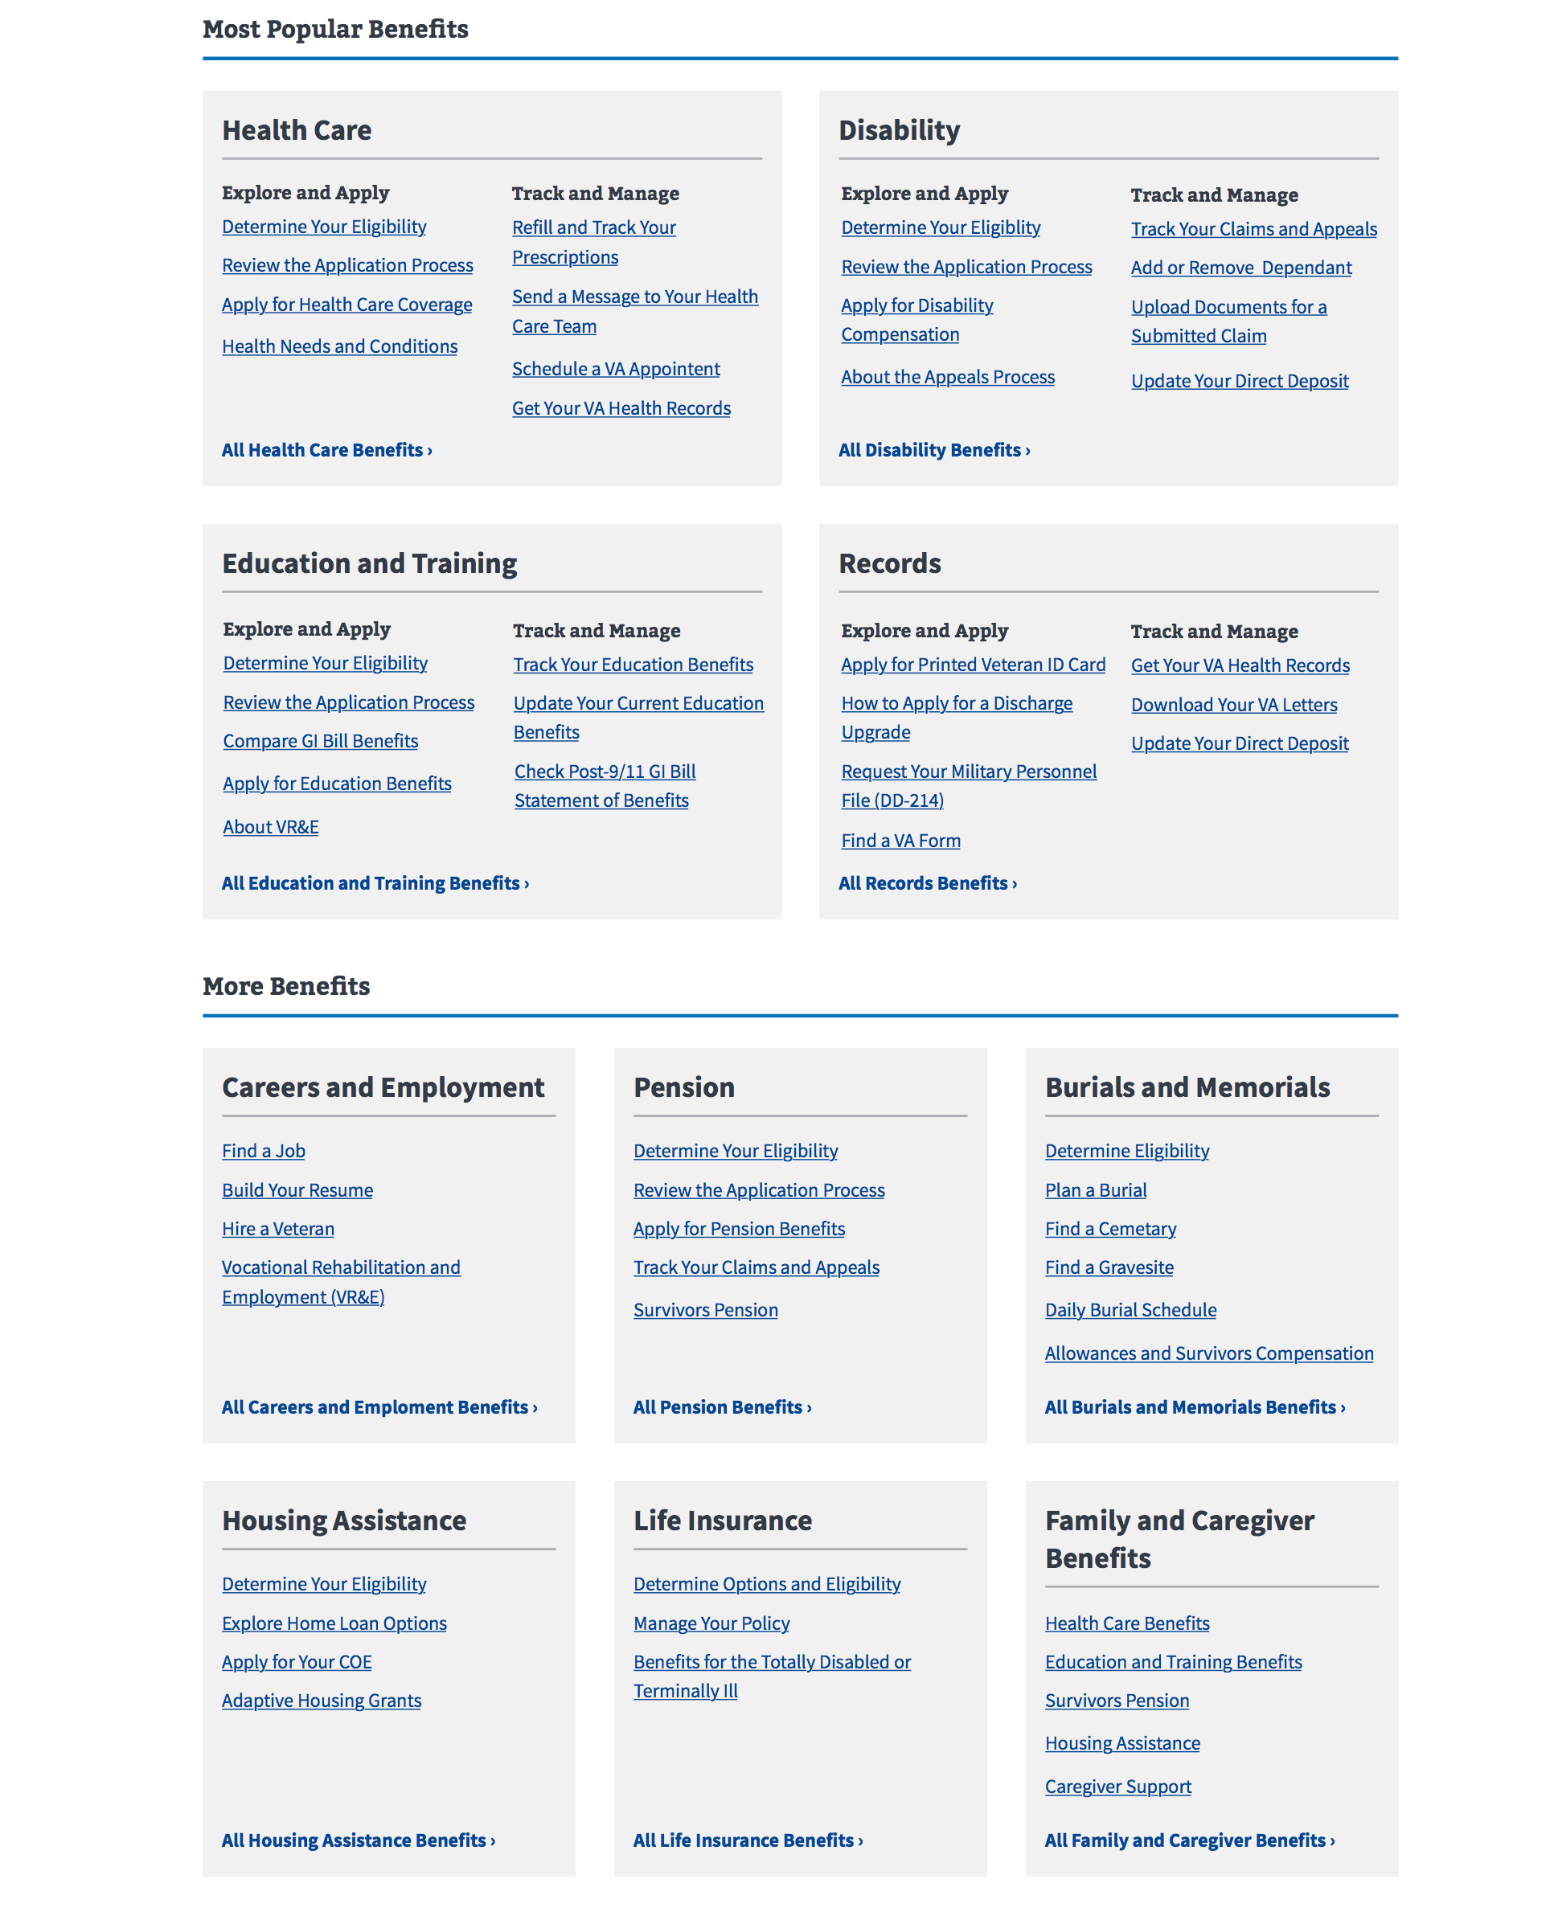
Benefit Category Homepage
Research method
Zone 2 listed the top 4 benefit categories with top tasks listed under “Explore & Apply” or “Track & Manage”
Zone 3 showed the remaining benefits with lists of top tasks for each

Slide 29
We learned that Veterans want the context of the benefit category but also quick links
Findings
7/10 preferred “Benefit Category” design over “Top Tasks”
Benefit hubs were confirmed as a good organization method
Veterans wanted the most popular list in each benefit but were overwhelmed by the number of choices
Separating top tasks from benefit labels was “distracting”
Both designs were “clean” but “boring” and needed more images
Appreciation for the one-click access to top resources

Slide 30
In their own words…
Findings
“The other one [Top Tasks] is more visually pleasing, but this one [Benefit Categories] seems like it packs more information and links in.” – P5
“I like that the three things I said I would go on here for are at the top.”
– P8
“It looks pretty user-friendly. You’ve got it categorized pretty well.” – P7
"The headings make it easy to find information” – P4
“Images would be good, it looks boring.” – P2
“I mean I like it – don’t get me wrong – but I think it has too much. My eyes go all over.” – P6

Slide 31
What Now?
Recommendations
We are updating our designs to incorporate the user feedback. These designs will go to our next round of user testing.

Slide 32
We plan to make these changes based on user feedback.
Recommendations
Top Tasks design
Reduced tasks from 22 to 16
Chunked tasks together for scanning
Benefit Category
Reduced the number of links: 5-6 for the larger benefit categories, 3 links for the smaller benefit categories
Refined the links for each benefit category to be top tasks
Removed the benefit lifecycle sub-headings

Slide 33
We plan to make these changes based on user feedback.
Recommendations
Both designs
Increased the fidelity of both designs to increase visual interest through icons and images
Added crisis line and Help link
Continued to use “view all” buttons/links
Added faces of veterans to the bottom of both designs

Slide 34
Study 3b – Homepage Wireframes v2

Slide 35
Our goal was to gather feedback on two homepage designs
Study objectives
Which of our revised design concepts works best for Veterans?
What are the pros/cons of each?
What do Veterans think of the revised top task approach?
What do they think of the look and feel?
What do they think about the two CTA button layout options?

Slide 36
We spoke with Veterans in person to learn more about what works for them.
Research Method
Visited Ft Belvoir CBOC (part of DC MC)
Spoke with 9 men Veterans of varying ages and races
Showed them two revised homepage designs (paper wireframes)
Asked structured questions to gather feedback (similar questions to study 3a)

Slide 37
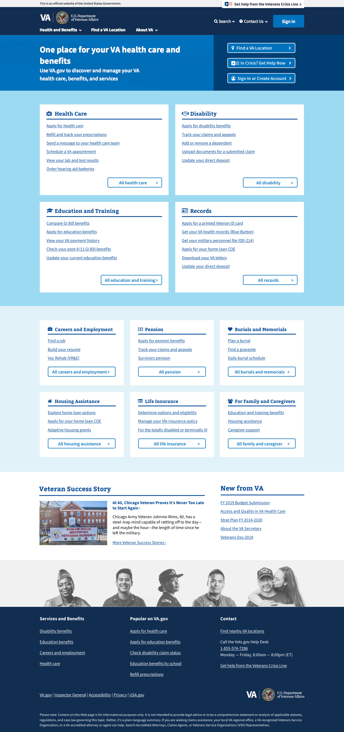
Research Method
Header
Zone 1 – Welcome, location, login
Zone 2 – Top tasks or benefits
Zone 3 – All benefits
Zone 4 – Good news stories, inside VA
Footer

Slide 38
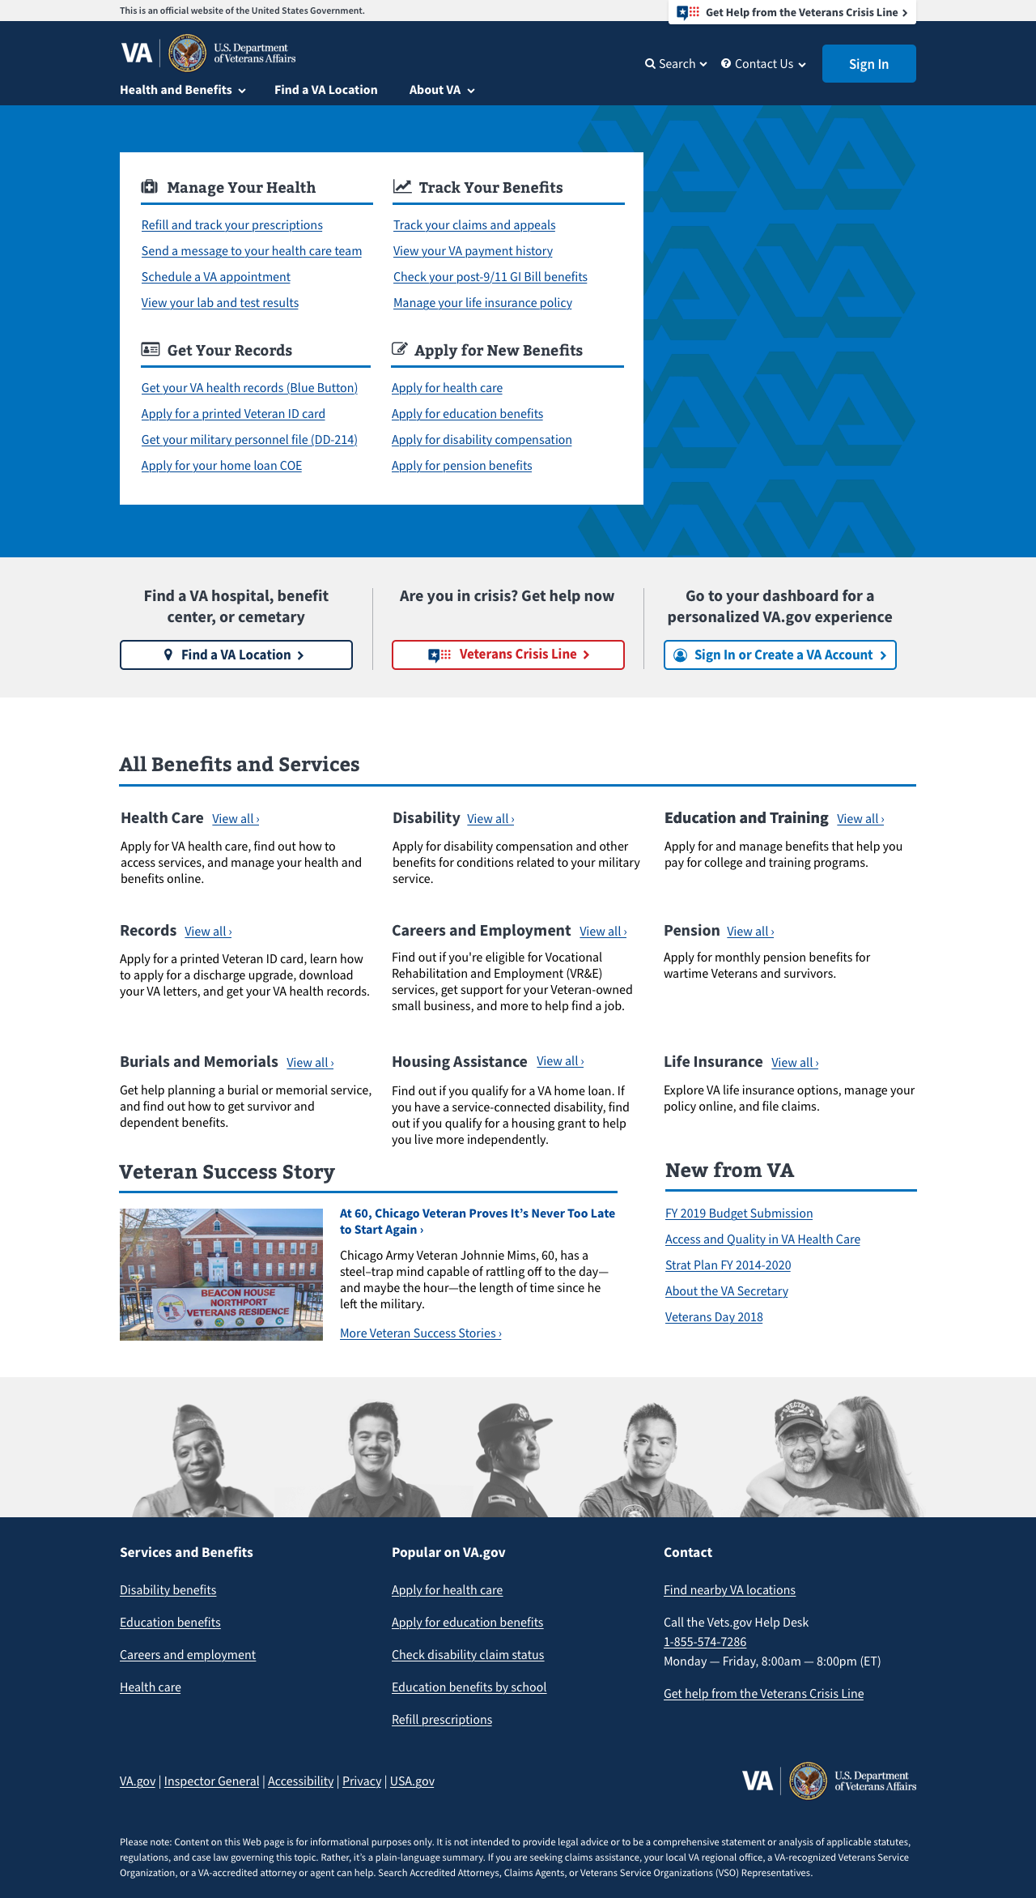
Research Method
Header
Zone 1 – Welcome, location, login
Zone 2 – Top tasks or benefits
Zone 3 – All benefits
Zone 4 – Good news stories, inside VA
Footer

Slide 39
Top Tasks Homepage v2
Research Method
Zone 1 focused on the top tasks organized under manage health, track benefits, get records, apply for benefits
Zone 2 had the location, crisis line, and sign-in
Zone 3 listed each benefit category with a simple description and CTA

Slide 40
Benefit Category Homepage v2
Research method
Zone 1 had the location, crisis line, and sign-in
Zone 2 listed the top 4 benefit categories with top tasks
Zone 3 showed the remaining benefits with lists of top tasks for each

Slide 41
These results are not yet available…
Findings

Slide 42
Thank you!
Contact Jeff Barnes with questions:
jeffrey.barnes4@va.gov

